Slide 1
Breast Cancer Prediction Model
Team:
Akhil A Kumar - AM.SC.P2ARI24002
Amelsha B - AM.SC.P2ARI24019
Rohith - AM.SC.P2ARI24013

Slide 2
Introduction
Objective
Develop a model to classify breast cancer as malignant or benign, aiding early diagnosis for better patient outcomes.
Dataset
Using Breast_cancer.csv from Kaggle, with key diagnostic features.
Tools
Python (pandas, sklearn, Streamlit)
Goal:
Compare models to find the most accurate classifier for reliable breast cancer prediction.

Slide 3
Problem Definition
Problem Being Addressed
Predict and classify breast cancer cases as malignant or benign for early diagnosis.
Assumptions
Dataset is clean and accurately labeled.
Selected features effectively distinguish cancer types.
Relevance
Supports timely and accurate patient diagnosis.
Enhances healthcare efficiency by reducing diagnostic time.
Contributes to broader tech-driven early cancer detection.

Slide 4
Dataset
Features
Clump Thickness: Measures the thickness of cell clusters, indicative of tumor compactness.
Uniformity of Cell Shape: Reflects the consistency of cell shape, with abnormalities suggesting malignancy.
Marginal Adhesion: Assesses how well cells adhere, with lower adhesion linked to malignant cells.
Single Epithelial Cell Size: Indicates size variations in epithelial cells, a key cancer indicator.
Bare Nuclei: Refers to nuclei without surrounding cytoplasm, often found in malignant cases.

Slide 5
Dataset (Continued)
Bland Chromatin: Evaluates the texture of cell nuclei, with variations suggesting malignancy.
Normal Nucleoli: Counts nucleoli within cells; abnormalities may point to cancer.
Mitoses: Measures the rate of cell division; high rates are commonly seen in tumors.
Class: Target variable, with values indicating malignant (1) or benign (0) cases.

Slide 6
Data Preprocessing
Feature Selection: Retain essential features relevant for accurate classification.
Handling Missing Values: Fill or remove any missing data points, especially in critical features like Bare Nuclei.
Encoding Target Variable: Ensure the target variable (Class) is binary and appropriately labeled.
Splitting Data: Divide data into training and testing sets to evaluate model performance

Slide 7
Model Selection
Algorithms Used:
Logistic Regression
Decision Tree
Random Forest.
Cross-Validation:
Use of K-Fold cross-validation for model evaluation

Slide 8
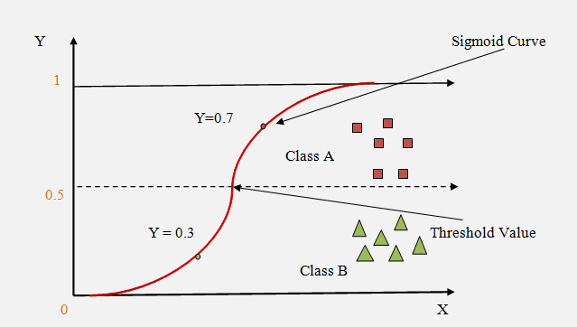
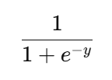
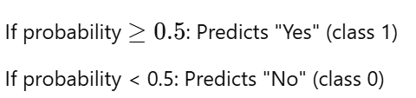
Logistic Regression
What is Logistic Regression?
A popular algorithm for binary classification tasks (e.g., Yes/No, 0/1).
Used to predict the probability of an outcome belonging to one of two classes.
Equation of line segment Y= mx + c
Where m is the slope
X is the input and c is the intercept
Sigmoid function
Makes predictions based on this probability:

Slide 9
Advantages and Limitations of Logistic Regression
Advantages
Easy to Understand: Provides interpretable results.
Efficient: Works well with small to medium-sized datasets.
Good for Binary Classification: Suitable for simple classification tasks.
Limitations
Assumes a Linear Relationship: Works best when the relationship between features and the outcome is linear.
Sensitive to Outliers: Extreme values can distort predictions.
Not Suitable for Complex Problems: Other models (e.g., Decision Trees, Neural Networks) may be better for more complex data.

Slide 10
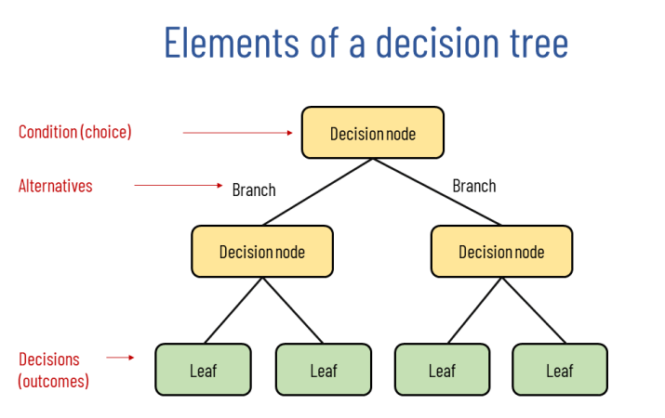
Decision Tree Architecture

Slide 11
Decision Tree Architecture
Decision Node (Yellow Boxes):
These nodes represent the points where a decision or split is made based on a specific feature or condition.
Each decision node examines a feature’s value, determining the direction to follow based on that value.
The root node (the first decision node at the top) initiates the process, while further decision nodes continue to refine the classification.
Branch (Connecting Lines):
Branches are the paths connecting decision nodes and leaf nodes.
Each branch represents a choice or alternative that results from the decision made at the parent node.
For example, a branch might signify whether a value meets a certain threshold, directing the path accordingly.

Slide 12
Decision Tree Architecture
Leaf Node (Green Boxes):
Leaf nodes are the terminal nodes in the tree. They represent the final outcome or decision.
Once a path reaches a leaf node, a classification label (or outcome) is assigned.
Each leaf node represents a unique class or prediction based on the sequence of decisions leading to it

Slide 13
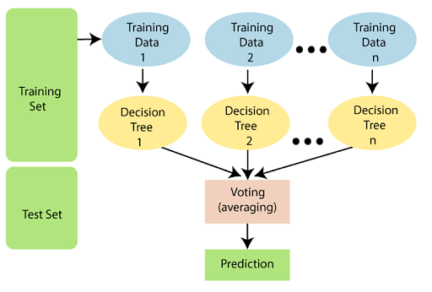
Random Forest Architecture

Slide 14
Random Forest Architecture
Training Set (Left Side, Green Box):
The data is split into a Training Set and a Test Set.
The Training Set is used to build multiple decision trees.
Data Sampling (Blue Ovals):
The Training Set is randomly sampled multiple times to create different subsets (shown as "Training Data 1," "Training Data 2," ..., "Training Data n").
Each subset is used to train an individual decision tree, providing diversity in the trees.
Decision Trees (Yellow Ovals):
Each sampled subset generates a unique decision tree (e.g., Decision Tree 1, Decision Tree 2, etc.).
These trees work as "weak learners," each providing individual predictions.

Slide 15
Random Forest Architecture
Voting/Averaging (Peach Box):
Once all decision trees make predictions, the Random Forest combines them.
For classification, it uses a majority voting mechanism; for regression, it averages the outputs of all trees.
Prediction (Final Green Box):
The final prediction is made based on the voting or averaging outcome, resulting in a robust classification or regression output.
This ensemble of trees increases accuracy and reduces overfitting compared to a single decision tree by averaging results across multiple models.

Slide 16
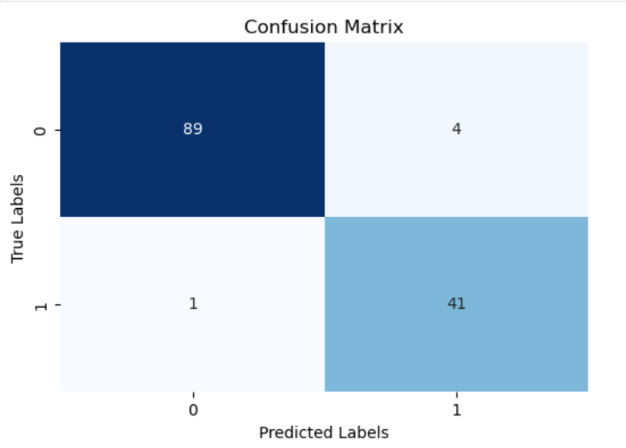
Results and Discussions
Accuracy score
Logistic regression:96%
Decision Tree:93%
Random Forest:97%
Confusion Matrix
Logistic Regression:

Slide 17
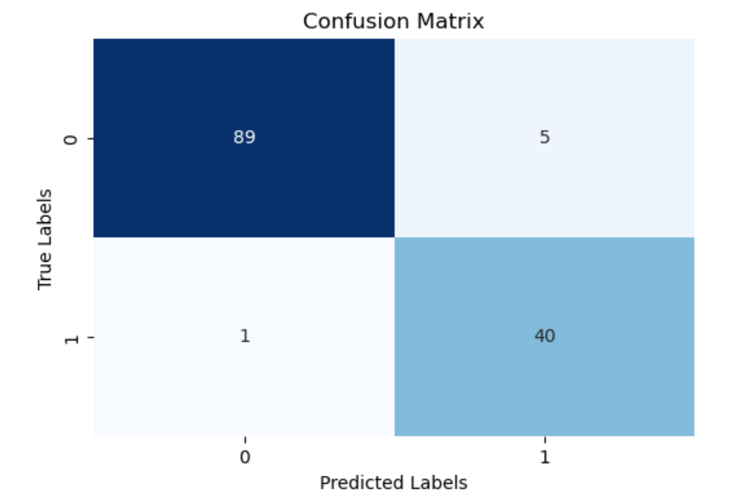
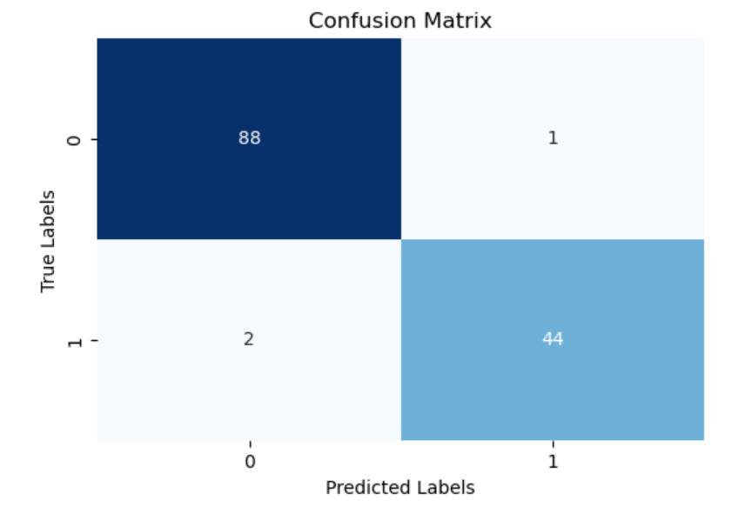
Results and Discussions
Decision Tree Classifier
Random Forest Classifier

Slide 18
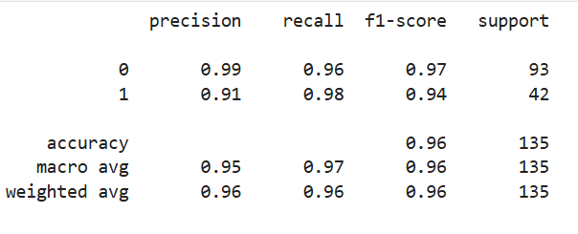
Results and Discussions
Classification Report
Logistic Regression

Slide 19
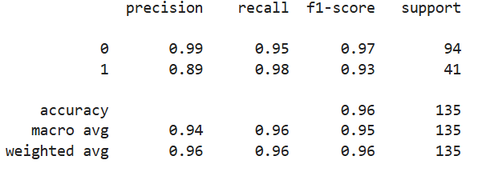
Results and Discussions
Decision Tree Classifier

Slide 20
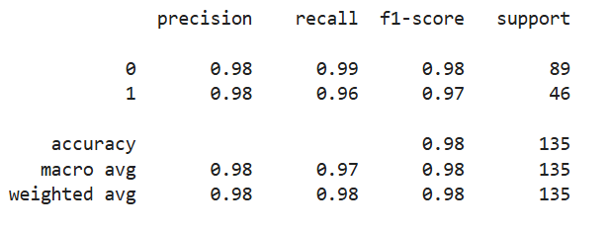
Results and Discussions
Random Forest Classifier

Slide 21
Conclusion
Best Model Selection: In our project , we explored several machine learning models, each with its own strengths and weaknesses. Logistic regression emerged as the best choice based on its simplicity, interpretability, and performance. Compared with other models logistic regression model has lesser number of false negative predictions which is very important for our case, making it natural fit for our project. Additionally, logistic regression provides probabilistic outputs, which can be very useful for understanding the confidence of the prediction.
Exported the model by creating pickle file
Deployed the model using streamlit library

Slide 22
References
Kohavi R. The Power of Decision Tables. In: 8th European Conference on Machine Learning, 174-189, (1995).
Quinlan R., Induction of decision trees. Machine Learning, vol. 1, 81-106, (1986).
Frank E., Ian H. Witten: Generating Accurate Rule Sets Without Global Optimization. In: Fifteenth International Conference on Machine Learning, 144-151, (1998)
Kohavi R., Scaling Up the Accuracy of Naïve-Bayes Classifiers: a Decision Tree Hybrid. In Proceedings of KDD-96, Portland, USA, 202-207, (1996).
]Aha D., Kibler D., Instance-based learning algorithms. Machine Learning. 6:37-66 (1991).

